Slide 1
WebRTC in IPC Live & Remote Rendering
Jiang Dunchun
2020/09/01
2020
R&D
REPORT

Slide 2
Contents
1
remote rendering framework
2
NAT
3
IPC Live
4
WebRTC
5
@TODO
6
reference

Slide 3
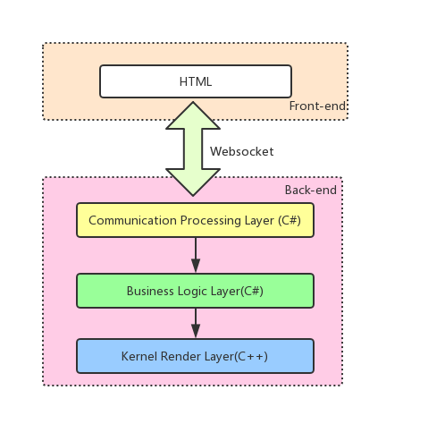
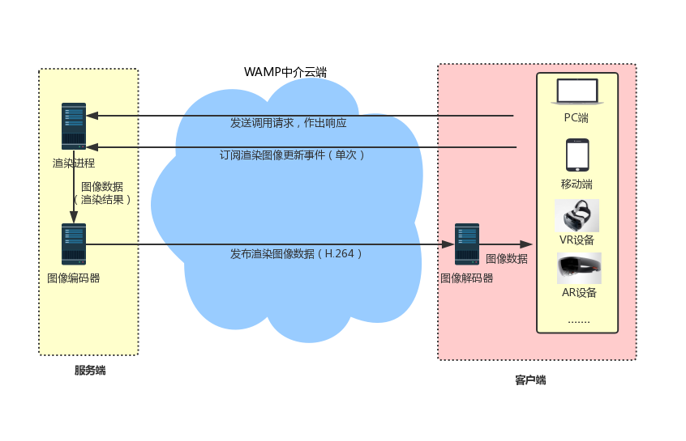
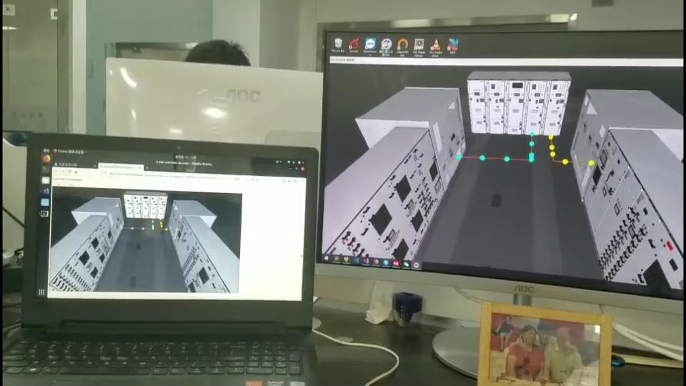
remote rendering framework
texture transfer
01
bandwidth pressure
encode & decode
02
WebAssembly [1] + ffmpeg + webGL
bad performances in front-end

Slide 4
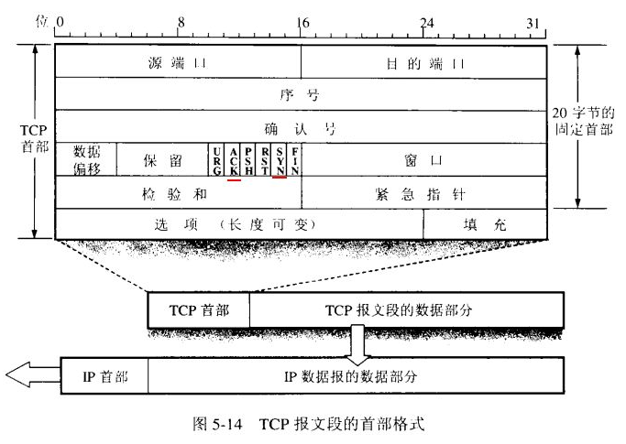
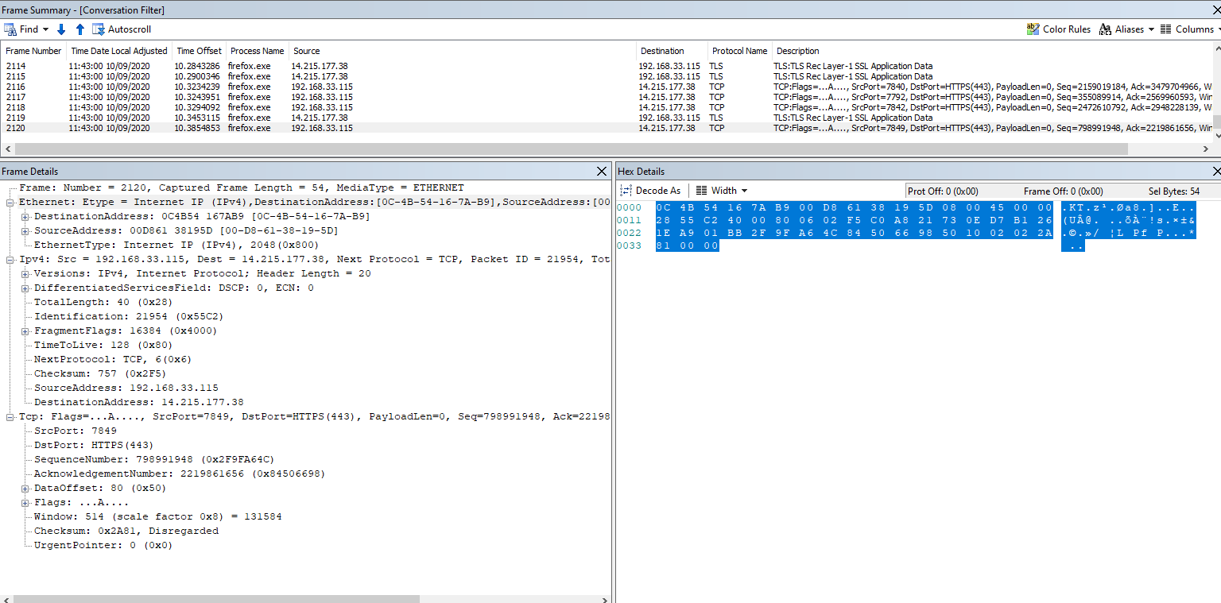
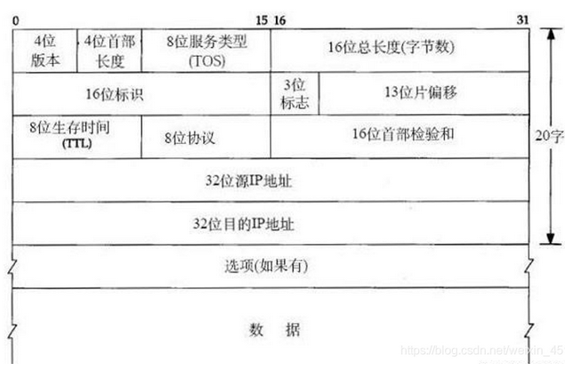
NAT

Slide 5
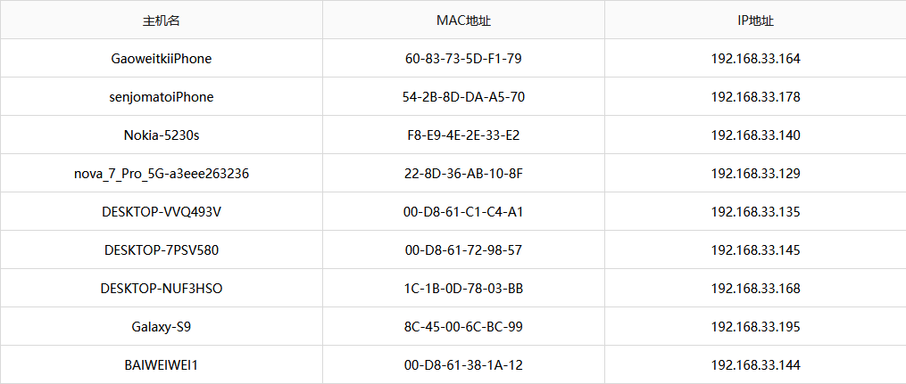
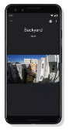
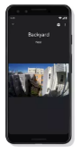
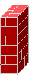
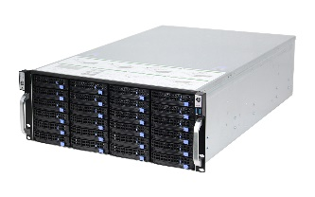
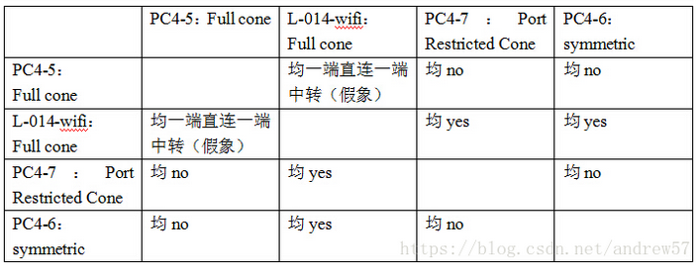
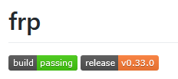
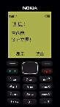
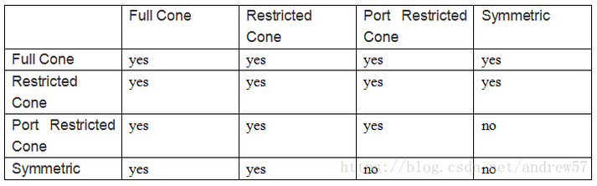
NAT
why NAT
01
IPv4 address count: 4,000,000,000 (2³²)
divide to private and public network
192.168.33.164
GaoweitkiiPhone
disadvantages
02
192.168.33.178
49.99.177.252
destroy Peer-to-Peer network
some project focus on deal with this problem
senjomatoiPhone
192.168.33.1
121.60.119.139
www.vrmaker.com.cn
NAT
192.168.33.140
using transmitting to expose service behind NAT to public network
Nokia-5230s

Slide 6
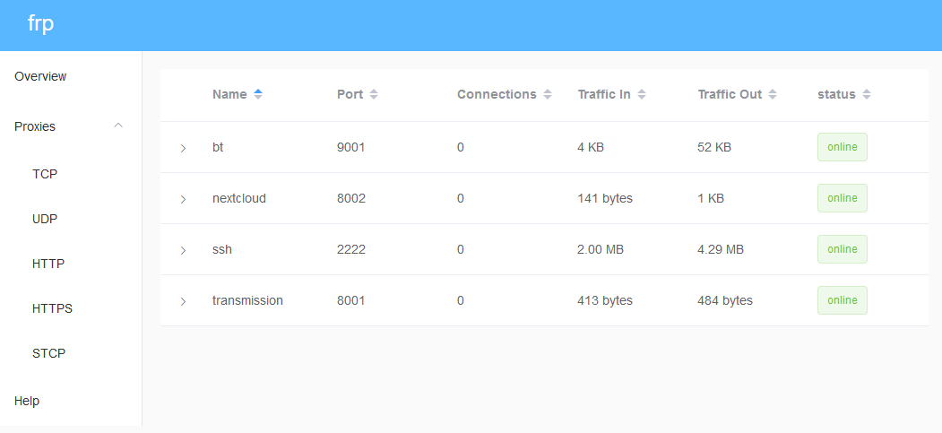

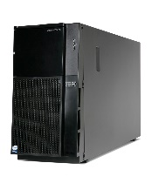
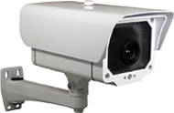
IPC Live
app
01
access anywhere
decoder
public network transmitting
frp server
02
frp + hls
bandwidth pressure of frp server
more than 5s delay
Data Channel
hls
rtsp
front-end
NAT
NAT
frp client
IPC

Slide 7
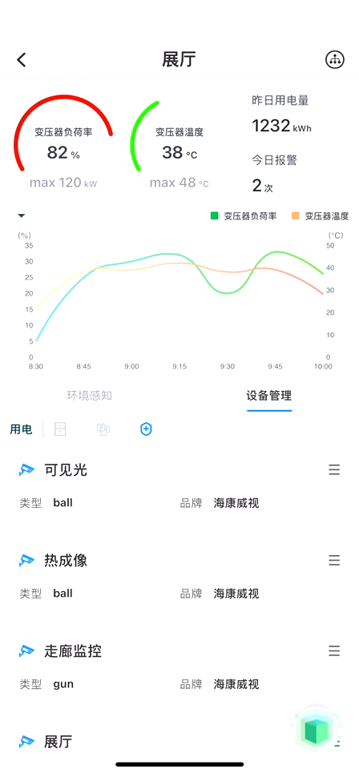


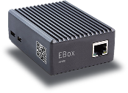
WebRTC
IPC live
01
ease bandwidth pressure of server
less than 1s delay
native decoder in browser
signal server
technology roadmap
02
decoder for rtsp & encoder for vp8
room in signal server
RESTful API
2 network transmitting
vp8
rtsp
stun server
1 data channel
NAT
ebox
IPC
front-end
NAT

Slide 8
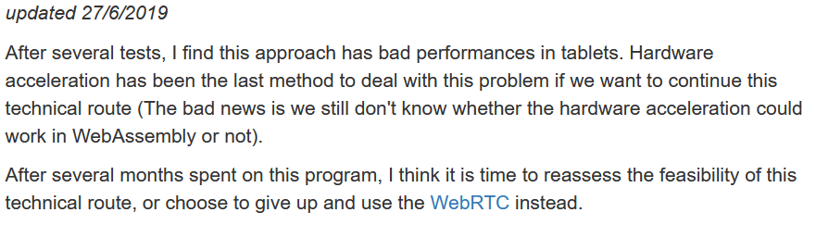
@TODO
linux
01
WebRTC native API for c++
remote rendering framework
02
native decoder for front-end

Slide 9
reference
[1] An Abridged Cartoon Introduction To WebAssembly
Lin Clark (Mozilla Developer Relations team)

Slide 10
Thanks. Especially these guys: Tian Rui, Zhang Tingfen, Ye Qinzhi, Yang Kai
THANKS
Jiang Dunchun
2020/09/01

